Slide 1
Memory Contention Aware Swap Space Management
Student：Su-Wei Yang
Advisor：Prof. Ya-Shu Chen
2019.07.29
Notes:
降低多個平行程式造成記憶體搶奪之現象

Slide 2
Outline
Introduction
Problem definition
Related work
System model
Approach
Experiment
Conclusion
Notes:
針對探討的問題做說明以及介紹我們的系統架構以及方法
最後再做個總結

Slide 3







Introduction
Notes:
隨著大數據以及人工智慧的崛起，各家廠商紛紛著重在計算晶片的研發

Slide 4
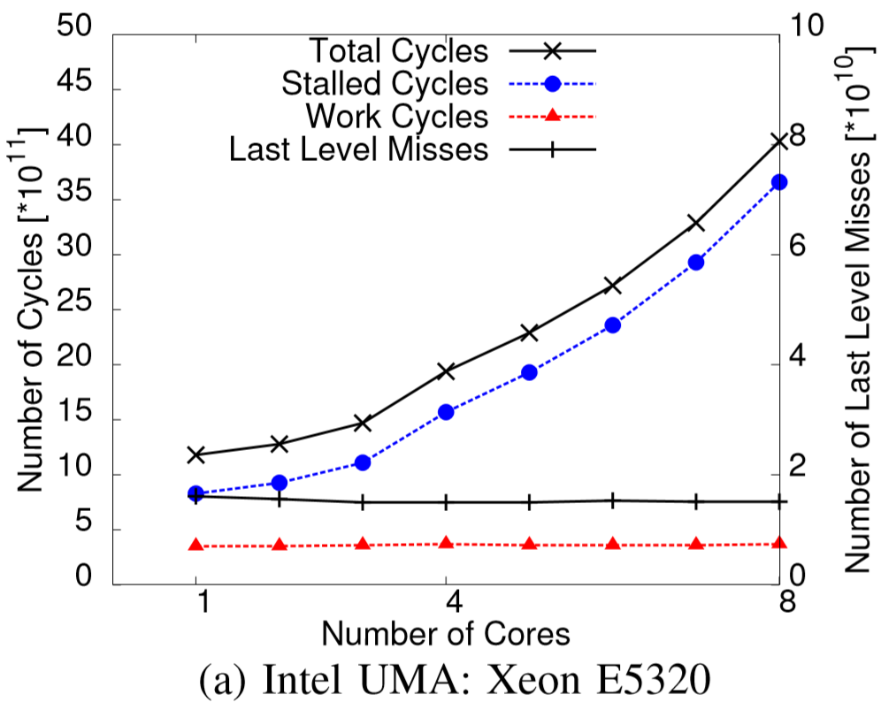
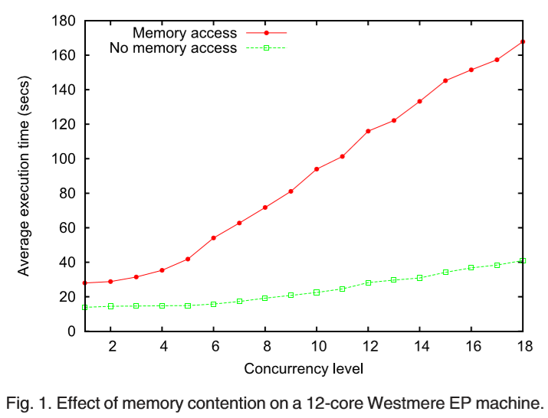
Introduction
BARDHAN, Shouvik; MENASCÉ, Daniel A. Predicting the effect of memory contention in multi-core computers using analytic performance models. IEEE Transactions on Computers, 2014, 64.8: 2279-2292.
TUDOR, Bogdan Marius; TEO, Yong Meng; SEE, Simon. Understanding off-chip memory contention of parallel programs in multicore systems. In: 2011 International Conference on Parallel Processing. IEEE, 2011. p. 602-611.
Notes:
那到達bottleneck會遭成哪些影響呢?
當一個application由越多項thread執行，其memory所造成的影響會越大，也就是左圖所表示，其速度並不會如預期般的提升，反而造成額外的latency
而若有多項application一同執行，其所造成的latency也有上升的趨勢

Slide 5
Introduction
System Model
CPU
GPU
Unified Memory Architecture (UMA)
https://devblogs.nvidia.com/unified-memory-in-cuda-6/
TUDOR, Bogdan Marius; TEO, Yong Meng; SEE, Simon. Understanding off-chip memory contention of parallel programs in multicore systems. In: 2011 International Conference on Parallel Processing. IEEE, 2011. p. 602-611.
Notes:
假如applications像是深度學習的model需要大量的core做運算，勢必就會遇到上述的情形
而我們這篇論文硬體是構築在所謂的UMA架構，也就是各個core都能對於memory做存取的要求，
這種架構對於系統的記憶體擁有更快的存取流程，但也意味著嚴重的bottleneck。

Slide 6
Introduction
Memory Contention
Commands
Contention problem
Memory controller
BARDHAN, Shouvik; MENASCÉ, Daniel A. Predicting the effect of memory contention in multi-core computers using analytic performance models. IEEE Transactions on Computers, 2014, 64.8: 2279-2292.
Notes:
那到底哪些因素會造成上述的latency?
第一個問題-memory contention，當各個core都有自己的工作，各自向memory buffer發出請求，
而kernel一次能處理的request數量有限，此情況底下，若由像gpu這樣的硬體來做存取，這個現象就會導致整體的performance下降。

Slide 7
Introduction
Memory Thrashing
Thrashing problem
BARDHAN, Shouvik; MENASCÉ, Daniel A. Predicting the effect of memory contention in multi-core computers using analytic performance models. IEEE Transactions on Computers, 2014, 64.8: 2279-2292.
Notes:
而除了第一個問題外，另一個問題也會造成performance下降，當多項記憶體loading較重的application一同執行時，
通常會導致記憶體不足的現象產生，作業系統通常採用比較消極的做法，將沒有在動作的page當作是victim由memory移到swap space當中，好讓當前想要使用記憶體的人能夠獲得滿足，但是當每個application都以這種形式來獲取memory，就會造成performance大幅的下降，也就是我們要索要探討第二個問題-memory thrashing。

Slide 8
Problem definition
Given
Applications
Goal
Minimize latency by reducing memory contention and thrashing
Method
Contention-aware scheduling
Swap space assignment
Constraint
Memory Size
Notes:
因此我們希望在得知既有的application的情況下，
以固定的memory size作為限制，以我們的方法來達到上述兩個問題所造成的latency。

Slide 9
Related work
Memory contention
JOUPPI, Norman P., et al. [1] present the bottleneck from computing component to memory when the chip is powerful
TUDOR, Bogdan Marius; TEO, Yong Meng; SEE, Simon. [2] provides the latency measurement to evaluate memory contention.
BARDHAN, Shouvik; MENASCÉ, Daniel A. [3] present the memory contention increased with an increased number of applications or cores.
[1] JOUPPI, Norman P., et al. In-datacenter performance analysis of a tensor processing unit. In: 2017 ACM/IEEE 44th Annual International Symposium on Computer Architecture (ISCA).
[2] TUDOR, Bogdan Marius; TEO, Yong Meng; SEE, Simon. Understanding off-chip memory contention of parallel programs in multicore systems. International Conference on Parallel Processing. IEEE, 2011.
[3] BARDHAN, Shouvik; MENASCÉ, Daniel A. Predicting the effect of memory contention in multi-core computers using analytic performance models. IEEE Transactions on Computers, 2014, 64.8: 2279-2292.
Notes:
第一篇: 提到當運算晶片相當快速的情況下，bottleneck會轉嫁到memory上面
第二篇: 提出了一項以latency來評估memory contention情形的公式
第三篇: 說明memory contention是會隨著application或是core數量的增加而增加

Slide 10
Related work
Reducing memory thrashing
Chen, Li, et al.[4] present a way to reduce memory thrashing by controlling SM open and close while memory thrashing occurs.
Reducing latency by swapping
Zhu, Xiao, et al. [5] present to swap applications memory pages out early to reduce latency
ZHUANG, Zhenyun, et al. [6] present the latency increased by inappropriate swapping
[4] LI, Chen, et al. A Framework for Memory Oversubscription Management in Graphics Processing Units. In: Proceedings of the Twenty-Fourth International Conference on Architectural Support for Programming Languages and Operating Systems. ACM, 2019. p. 49-63..
[5] Zhu, Xiao, et al. "SmartSwap: High-performance and user experience friendly swapping in mobile systems." Proceedings of the 54th Annual Design Automation Conference 2017. ACM, 2017
[6] ZHUANG, Zhenyun, et al. Taming memory related performance pitfalls in linux cgroups. In: 2017 International Conference on Computing, Networking and Communications (ICNC). IEEE, 2017.
Notes:
第四篇: 提出了以開關SM的方法來將低memory thrashing的影響
第五篇: 提出了一套方法，將某些application 預先移至swap sapce，好讓其他application在memory 裏頭能夠讓使用者獲得較好的體驗。
第六篇: 說明若做了不好的swap 政策，會導致latency上升的更嚴重。

Slide 11
Framework
System Model
Host
User Space
Multiple applications
Request Queue
Contention-aware
Scheduling
Kernel Space
Swap Space Management
DMA Queue
Task Queue
SSD
MEM
GPU
Notes:
當多個application進入系統作執行，並發生了latency的狀況以及thrashing的發生時，就會觸發我們的政策，各項application所發起的memory request會由我們的scheduling在各個queue中做安排，並以我們針對swap space的安排做執行。

Slide 12
Approach
Contention-aware Scheduling
Memory contention evaluation
Contention-aware priority assignment
Swap space management
Direct swap space accessing
Contention-aware swap-in strategy
Swap space assignment
Notes:
我們共分為兩個政策
第一個為排程，目的是要降低memory contention的程度
第二個為swap的管理，目的是要降低memory thrashing所帶來的影響

Slide 13

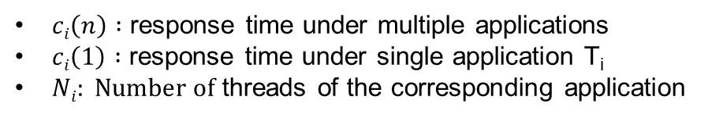
Scheduling
Approach
Memory contention degree evaluation
$ωi\left(n\right)=\frac{ci\left(n\right)−ci\left(1\right)}{ci\left(1\right)} ∗\frac{1}{Ni}$
T₁
T₂
System
T₃
T_{n}
$ci\left(n\right) :$ response time under multiple applications
$ci\left(1\right) :$ response time under single application T_{i}
$Ni: Number of$ threads of the corresponding application
TUDOR, Bogdan Marius; TEO, Yong Meng; SEE, Simon. Understanding off-chip memory contention of parallel programs in multicore systems. In: 2011 International Conference on Parallel Processing. IEEE, 2011.
Notes:
首先我們會將contention的程度做一個量化的動作，分為兩個部分，公式的左半邊是以latency來評估application i 所受的影響，
藉由latency對比上原始所執行的時間，可得知contention對這個application帶來多大的影響。

Slide 14



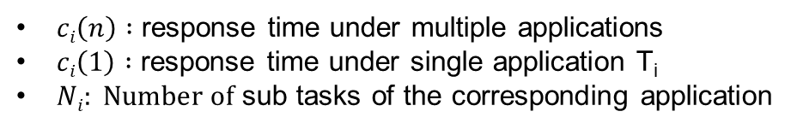
Scheduling
Approach
Memory contention degree evaluation
$ωi\left(n\right)=\frac{ci\left(n\right)−ci\left(1\right)}{ci\left(1\right)} ∗\frac{1}{Ni}$
$$C_{i}(1)$$
$$C_{i}\left(n\right)−C_{i}(1)$$
Different number of sub tasks
$ci\left(n\right) :$ response time under multiple applications
$ci\left(1\right) :$ response time under single application T_{i}
$Ni: Number of$ sub tasks of the corresponding application
TUDOR, Bogdan Marius; TEO, Yong Meng; SEE, Simon. Understanding off-chip memory contention of parallel programs in multicore systems. In: 2011 International Conference on Parallel Processing. IEEE, 2011.
Notes:
接著我們考慮到單純從latency的角度出發並不夠，如圖所示，有可能不同的application雖然擁有同樣的latency，
但其對於contention的影響卻不一樣，例如application123雖然擁有一樣的latency，但其對於memory的request頻率卻不相同
，因此我們加入了第二項因素，sub task作為我們評估contention程度的方式。

Slide 15
Scheduling
Approach
Contention-aware priority assignment
Setting the priority by contention degree.
The higher contention degree the higher priority.
Request Queue
Memory
GPU
Notes:
原本有contention的情況底下，可以看到application 1之間夾著application2的request，而導致時間拉長，
而application2的request之間也夾著application1，導致額外的latency

Slide 16
Scheduling
Approach
Contention-aware priority scheduling
Reduce the response time of the higher priority
Reduce the latency caused by memory contention
Request Queue
Memory
GPU
T1
T2
Notes:
而藉由degree作為依據的priority scheduling，能夠使application2擁有較高的優先權，來減少原本多出的latency

Slide 17
Approach
Contention-aware Scheduling
Memory contention evaluation
Contention-aware priority assignment
Swap space management
Direct swap space accessing
Contention-aware swap-in strategy
Swap space assignment
Notes:
第二個為swap的管理，目的是要降低memory thrashing所帶來的影響

Slide 18
Thrashing Problem
Reduce thrashing
Memory-oriented execution
Memory
T1
GPU
T2
Swap space
Notes:
現今作業系統主要是以memory為導向來執行任務，也就是任何任務都需要從記憶體來取得

Slide 19
Thrashing Problem
Reduce thrashing
Memory-oriented execution
Memory
GPU
T1
T2
Swap space

Slide 20
Thrashing Problem
Reduce thrashing
Memory-oriented execution
Memory
T2
GPU
T1
Swap space

Slide 21
Thrashing Problem
Reduce thrashing
Memory-oriented execution
Memory
T2
Thrashing
T1
Swap space
Notes:
若有多個application，容易導致thrashing發生，進而導致發生performance下降的情形

Slide 22
Thrashing Problem
Reduce thrashing
Latency increased by swapping
Request Queue
Memory
Swapping
GPU
Notes:
如這張圖所示，假設memory最多只能容納兩個sub task，當T2需要空間時，
必須等到T1被系統寫入到swap space中，自己才能夠使用，而當T1也需要空間時，
也就表示必須有人寫出memory到swap space中，T1才能執行，如這張圖的例子是T2，
若是有多項application，這個現象會導致相當大的一個bottleneck。

Slide 23
Swap Space Management
Approach
Direct swap space accessing
Memory
T1
GPU
T2
Swap space
Notes:
因此我們希望站在以直接和swap space溝通的硬體上面來消除剛剛所提到的bottleneck，也就是說，像是T2就能直接待在Swap space當中，藉由直接和GPU溝通的特性來減少thrashing的影響

Slide 24
Swap Space Management
Approach
Direct swap space accessing
Memory
T1
GPU
T2
Swap space

Slide 25
Swap Space Management
Approach
Direct swap space accessing
Memory
T1
GPU
T2
Swap space

Slide 26
Swap Space Management
Approach
Reduce latency
Direct swap space accessing
Request Queue
Memory
Swapping
GPU
SSD
https://tw.transcend-info.com/Support/FAQ-292
Notes:
就像這張圖所示，原先T2需要等待T1寫入，到swap space後才能於memory中做操作，
而直接存取swap space的特性能讓T1減少受到這個問題的影響，同時也降低memory中干擾造成的影響。

Slide 27
Swap Space Management
Contention-aware swap-in strategy
Swap in high priority application to reduce latency
Execute low priority application by direct swap space accessing to reduce thrashing
How to assign the swap space size to reduce thrashing?
Memory usage evaluation
Average distribute direct swap space accessing
Notes:
那我們的政策導向以高priority的人盡可能運行於memory，而低priority的人運行於swap space，來緩解thrashing帶來的影響。
而低priority的application要有多少比例的memory pages要運行在swap space當中?
我們提出了一套方法來設定之間的比例。

Slide 28

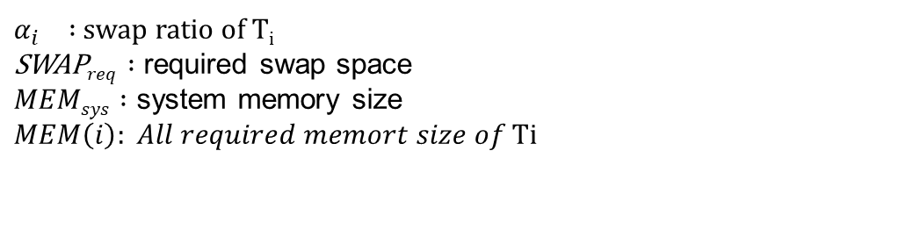
Swap Space Assignment
Reduce thrashing
Check the required memory size for all executing applications
SWAP$req=∑MEM(i)−MEMsys$
Sort all applications with priority
$α_{i} :$ swap ratio of T_{i}
$\text{SWAP}req :$ required swap space
$MEMsys :$ system memory size
$$MEM\left(i\right): All required memort size of \text{Ti}$$
Notes:
我們要先知道所有application所需要的memory pages超出整體系統的記憶體多少，同時藉由第一套方法設定priority

Slide 29
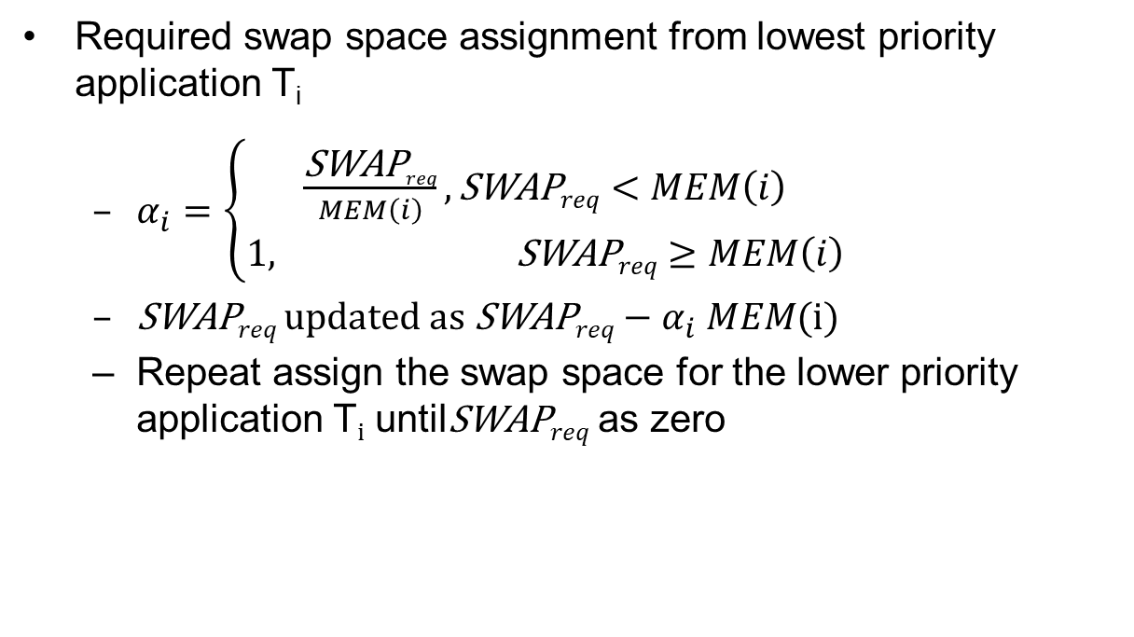
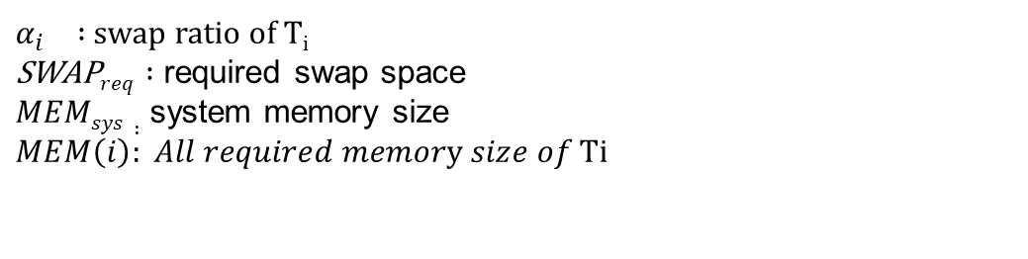
Swap Space Assignment
Approach
Required swap space assignment from lowest priority application T_{i}
$α_{i}=\left\{\begin{aligned}\frac{\text{SWAP}req}{MEM\left(i\right)},\text{SWAP}req<MEM\left(i\right) \\ &1, \text{SWAP}req≥MEM\left(i\right)\end{aligned}\right.$
$\text{SWAP}req updated as \text{SWAP}req−α_{i} MEM(i)$
Repeat assign the swap space for the lower priority application T_{i} untilSWAP$req$ as zero
$α_{i} :$ swap ratio of T_{i}
$\text{SWAP}req :$ required swap space
$MEMsys :$ system memory size
$$MEM\left(i\right): All required memory size of \text{Ti}$$
Notes:
接著從最低priority的application開始將記憶體配置在swap space當中，直到滿足了超出的記憶體，
若是最低priority的application無法滿足，則再由第二低priority的application繼續直到抵銷掉超出的記憶體。

Slide 30
Experiment Setup
Result
Setting
Applications number : 4
Sub tasks for each application : 5,7,9,11,128,256
Required memory of all applications : 24GB, 320MB
System memory constraint : 18GB,240MB
Performance Evaluation
Lengthened latency
Comparison
Baseline(non-swap management)
MaT[4]
[4] LI, Chen, et al. A Framework for Memory Oversubscription Management in Graphics Processing Units. In: Proceedings of the Twenty-Fourth International Conference on Architectural Support for Programming Languages and Operating Systems. ACM, 2019. p. 49-63.

Slide 31
Performance
The same

Slide 32
Performance
The different

Slide 33
Performance
benchmark

Slide 34

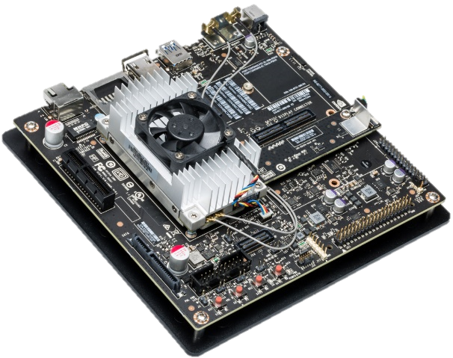
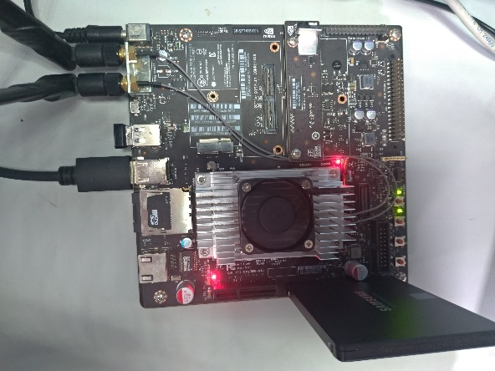
Case Study
Result
Platform (Nvidia TX2)
CPU ： Denver CPU (2 cores)+ Cortex A57 CPU (4 cores)
Memory ： 8GB LPDDR4
Total swap space：16GB
Storage device ：Samsung 860 EVO SSD (SATA3.0)
https://www.arrow.com/en/products/945-82771-0000-000/nvidia
https://www.samsung.com/tw/memory-storage/860-evo-sata-3-2-5-ssd/MZ-76E250BW/

Slide 35
Experiment Setup
Result
Applications
Application number : 3
Required of all applications : 9GB
OS:Ubuntu16.0.4
Kernel version : Linux 4.4.38
Container: Cgroup
Performance Evaluation
Response time

Slide 36
Default Management
Results
T1
System Memory 8GB
Swap space (SSD)
Allocate 3GB
T2
Allocate 3GB
T3
Large cost
Allocate 3GB
Notes:
有三個TLICATION，我們做法是random取allocate好的地址，好讓系統會發生thrashing問題，當多個地址被access，
就會有很大的機會發生上述提到的搬移

Slide 37
Our Swap Management
Results
T1
System Memory 8GB
Swap space (SSD)
Allocate 3GB
T2
Allocate 3GB
T3
Minimize cost
Allocate 3GB

Slide 38
Result
Results
Without swap management
Response time(s) | T1 | T2 | T3 | Total
First | 23.39 | 22.97 | 12.44 | 58.80
Second | 23.27 | 22.75 | 11.65 | 58.37
Third | 23.9 | 22.68 | 12.48 | 59.06
With swap management
Response time(s) | T1 | T2 | T3 | Total
First | 13.44 | 14.31 | 21.52 | 49.27
Second | 14.48 | 13.85 | 21.64 | 49.97
Third | 13.53 | 14.33 | 21.37 | 49.23

Slide 39
Conclusion
Conclusion
Executing multiple data-oriented applications introduces
Memory contention
Thrashing
Proposed memory contention-aware scheduling and thrashing elimination strategy
Contention-aware scheduling
Swap space management
Performance evaluation
Combing scheduling and direct swap accessing can minimize latency up to 41.3%
Eliminate the thrashing can reduce latency up to 16.6% on the real platform

Slide 41
Swap Space Management
Approach
Reduce latency
Direct swap space accessing
Request Queue
Memory
Swapping
GPU
SSD
Ex.
Memory : ~20000MB/s(ddr4+pcie)
SSD : ~495MB/s (Samsung SSD 860Evo+SATA3.0)
https://tw.transcend-info.com/Support/FAQ-292
Notes:
就像這張圖所示，原先T2需要等待T1寫入，到swap space後才能於memory中做操作，
而直接存取swap space的特性能讓T1減少受到這個問題的影響，同時也降低memory中干擾造成的影響。

Slide 42
Performance
16G-
4 applications

Slide 43
Performance
16G-
8 applications

Slide 44
Performance
16G-4applications

Slide 45

Technique Issues
How?
Tlications
Memory Contention & Thrashing
When?
Who?
Notes:
因此，當多項application發生memory contention 以及thrashing的問題時，我們必須決定
需要對哪些application實施政策，什麼時候以及如何實施。

Slide 46
Experiment
Setting
Tlications Number : 4
Sub tasks for each Tlication : 5*3, 20*1
Memory allocation for each sub task : 400000,100000
Ready, Waiting, GPU execution time : 100
Performance Evaluation
Latency
Evaluate the latency of each application.
Energy Consumption
Evaluate the energy consumption of RAM and SSD.

Slide 47
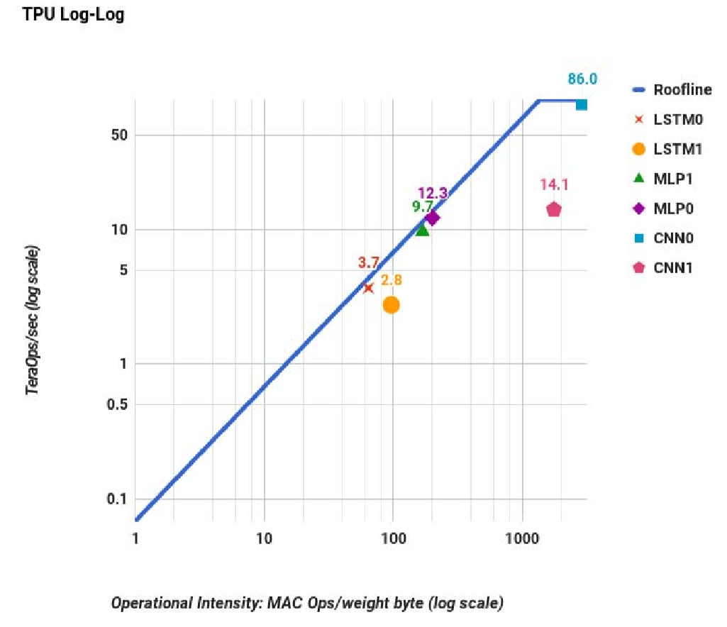
Introduction
FLOPs
GOOGLE TPU
Operational Intensity
JOUPPI, Norman P., et al. In-datacenter performance analysis of a tensor processing unit. In: 2017 ACM/IEEE 44th Annual International Symposium on Computer Architecture (ISCA). IEEE, 2017. p. 1-12.
Notes:
提到當計算晶片非常快速時，其系統的bottle neck會有轉移到memory的趨勢

Slide 48
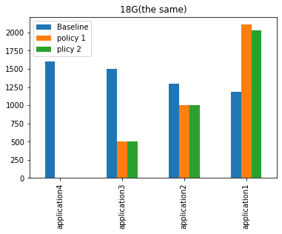
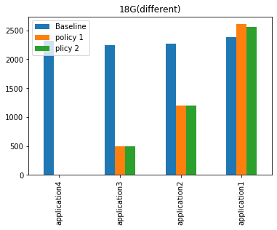
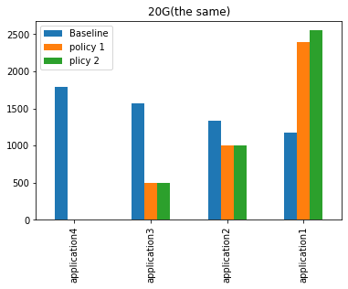
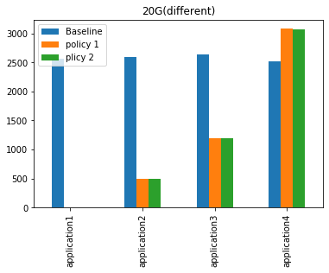
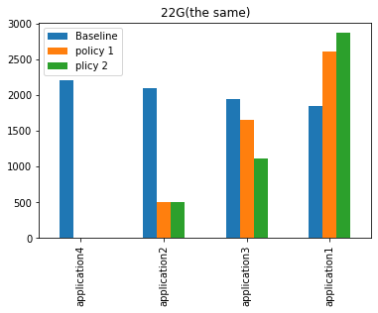
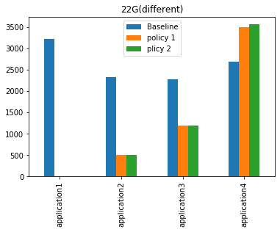
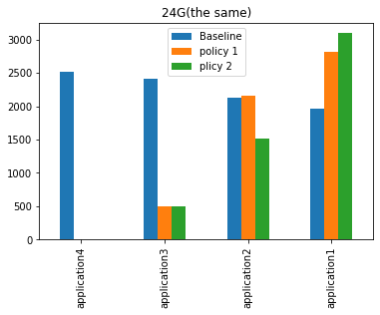
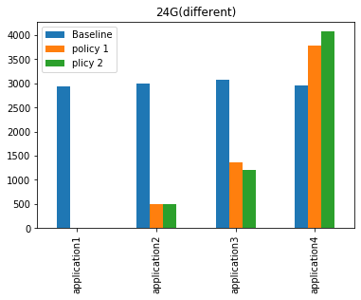
Result
Thrashing happen
Memory Size = 16GB
Priority: high->low

Slide 49
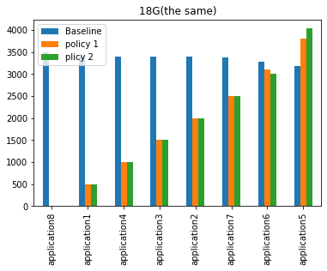
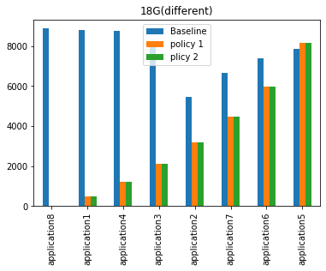
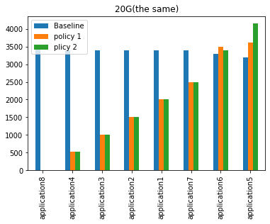
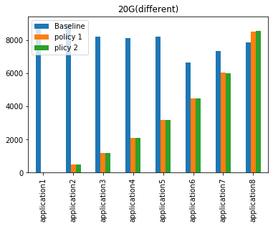
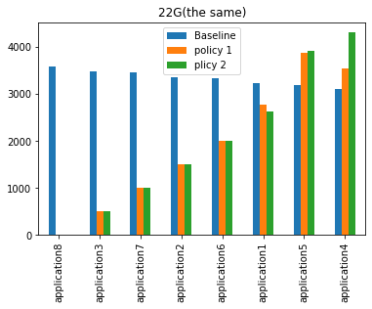
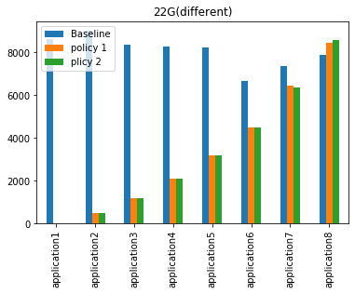
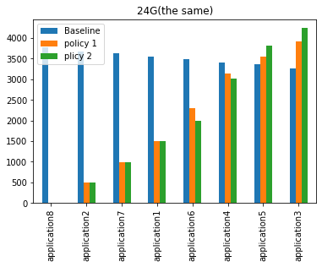
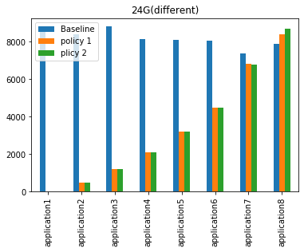
Result
Thrashing happen
Memory Size = 16GB
Priority: high->low

Slide 50
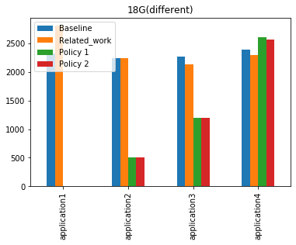
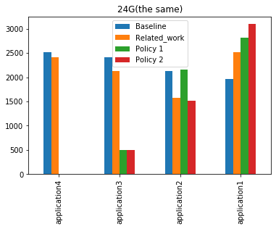
Result
4 applications

Slide 51
Result
8 applications

Slide 52
Experiment
On TX2
 | Time(s) |  |  | Average(s)
Application 1 | 13.34 | 10.45 | 10.90 | 11.56
Application 2 | 11.7 | 11.18 | 10.91 | 11.26
Application 3 | 12.51 | 11.85 | 10.81 | 11.72
 |  |  |  | 11.52
 | Time(s) |  |  | Average(s)
Application 1 | 10.65 | 9.72 | 11.44 | 10.60
Application 2 | 10.71 | 10.63 | 10.91 | 10.75
Application 3 | 10.73 | 10.63 | 11.73 | 11.03
 |  |  |  | 10.79

